Slide 1

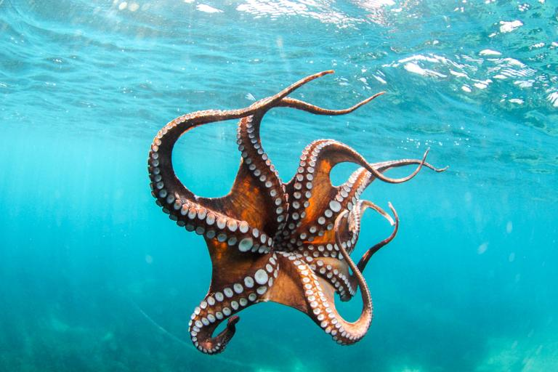

Spring 2017 CS 46B: Data Structures Module 1
Professor Phil Heller

Slide 2
Today
Administration
Defining data structures

Slide 3
Today
Administration
Defining data structures

Slide 4
Registration
You must have all the pre- / co-reqisites:
CS 46A or 49J, grade = C or better.
Eligible for Math 30 or 30P
C or better in Math 19 or passed xxxxxxx
Math 42 with passing grade, or taking it this semester.
Evidence:
Hardcopy only. Stapled or paperclipped.
Don’t need official transcript – printed screenshot of MySJSU or equivalent is ok (“unofficial transcript”).
Mark pre- / co-requisites, preferably with highlighter.
On back of last page:
Email address, big and neat
“MS” if you’re a grad student, “GS” if you’re a graduating senior, “E” if you’re enrolled, “OU” if Open University
Not enrolled ➔All lab sections you can take: SECTION #, NOT DAY/TIME
Notes:
http://artic.sjsu.edu/web-dbgen/artic/all-course-to-course.html

Slide 5
Documentation
Collected after class today Jan 30 and Wednesday Feb 1
Then:
Enrolled but missing prerequisites ➔ DROP
Enrolled but no Math 42 ➔ bring hardcopy proof of Math 42 by end of class Wednesday Feb 8, else DROP
All pre-/co-requisites but not enrolled ➔ RECEIVE ADD CODE WHILE THEY LAST. Notified by email. Use add code asap
Add code priority
Grad students
Graduating seniors
Other regular enrolled students
Open university
Last semester, almost every qualified student eventually got enrolled

Slide 6
Homework
Approx. 8 assignments
Complete programs, not pieces & methods
Start early
New assignments will be announced in lecture and posted to Canvas
No late homework accepted for any reason
Lowest homework grade is dropped

Slide 7
Homework: Grading
No Codecheck, no drafts
Most of your work is evaluated by software
Software is not subtle
Follow assignment instructions exactly
Don’t expect partial credit for partially correct work
You get a copy of the autograder code
~ 15% graded by hand: style, neatness, comments

Slide 8
Homework: Procedure
Download assignment doc, autograder, and (often) starter files from Canvas.
Create an Eclipse project; import the autograder and any starter files.
Work the assignment.
Optional, but you should do this a lot for each assignment: run the autograder to see how you’re doing.
Export your work as a jar.
Optional, highly recommended: test your jar.
Submit your jar to Canvas before the deadline.

Slide 9
Homework: Procedure
Download assignment doc, autograder, and (often) starter files from Canvas.
Create an Eclipse project; import the autograder and any starter files.
Work the assignment.
Optional, but you should do this a lot for each assignment: run the autograder to see how you’re doing.
Export your work as a jar.
Optional, highly recommended: test your jar.
Submit your jar to Canvas before the deadline.
Lab 1 shows you how to do all the stuff in red

Slide 10
Labs
1st labs are this week Jan 31 & Feb 3.
No labs next week Feb 7 & 10.
For weeks when lab is happening: you may miss 3 sessions. If you miss a 4th session you fail the entire course. No exceptions.
You can’t make up a missed lab. You can’t change lab section.
Bring your laptop to each lab. Power outlets aren’t guaranteed.
All labs involve programming in Java, using the Eclipse IDE. Try to install Eclipse before your first lab session.
Work in teams of 2. You choose your partner. Partnerships are permanent unless your lab TA sees uneven work sharing.
Scribe / Driver roles. Trade off week to week.
Lab report due before you leave. Lab grade based on graded lab reports.

Slide 11
Labs: How to ask for help
Indent correctly, comment well
Be ready to tell TA:
What output did you expect to see?
What output did you actually see?
How did you try to solve the problem yourself?

Slide 12
Exams
Greenbooks, no computers, 1 double-sided 8.5”x11” page of notes
2 midterms
Probably March 6 and April 5
15% each
Cumulative
Random scans
Final
Wednesday May 24, 12:15 – 2:30
Here
Cumulative

Slide 13
Piazza
Completely unsupervised. If you want me to contribute to a thread, email me.
No class-participation points.
Signup at piazza.com/sjsu/spring2017/cs46b.
Participate at piazza.com/sjsu/spring2017/cs46b/home.

Slide 14
Contacting Me
Office hours:
Tuesday 1:30 – 2:30 or by appointment
Not a session for me to do your homework
Email:
philip.heller@sjsu.edu
I don’t respond to Canvas mail
Phone:
Phone is for faculty contact only
I don’t respond to voicemail left by students

Slide 15
Internships and Recommendations
A letter from me that just says you got an A in my class doesn’t help you
I only recommend students who I’m familiar with
Quality time in office hours

Slide 16
Final Grades
If you passed the lab:
Homework: 35%, lowest score is dropped
Midterms: 15% each
Final exam: 35%
Canvas will tell you your lab, homework, and exam scores.
Canvas will not tell you a correctly weighted final score.

Slide 17
How to be helpful in this room
Rule 1: Don’t talk, whisper. And don’t whisper very much.
Rule 2: Don’t interrupt the lecture, even if someone sneezes. Silent blessings only.
Rule 3: Ask only relevant questions. Silently raise your hand and wait to be called on.

Slide 18
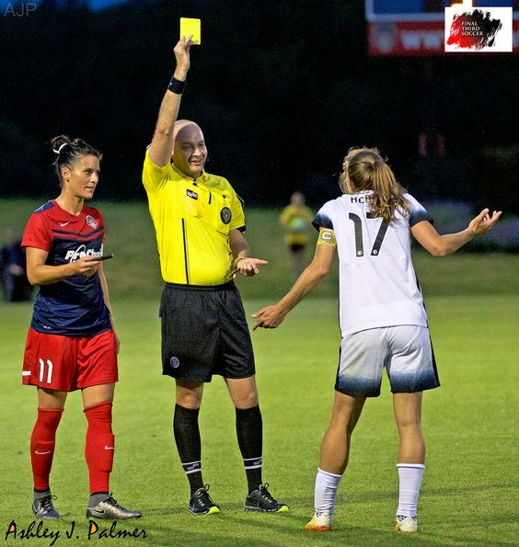
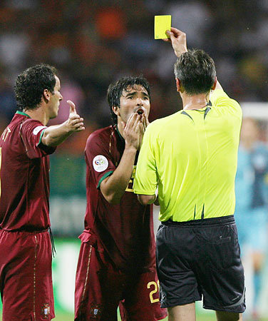
White Card Questions/Comments
The opposite of this
Write your name on the card and leave it on the table

Slide 19
White Card Questions/Comments
The opposite of this
A great comment or question that helps everybody learn
Write your name on the card and leave it on the table
It’s worth extra credit

Slide 20
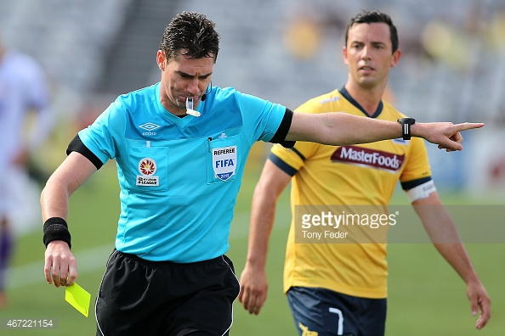
There are no yellow cards
Not yet

Slide 21
How to succeed
Come to all lectures
Write lots of Java

Slide 22
Today
Administration
Defining data structures
Notes:
The objects and processes of the world have structure. We see this at the molecular level, the organism level, and the planetary level. I know this because in my research I study the structure of information-carrying molecules #, the organisms those molecules regulate #, and how those organisms regulate the planet’s oceans #. I study them by writing Java programs about them that use data structures. I say this not to brag about my cool research program but to convince you that there are very cool jobs out there for you if you master Java.

Slide 23

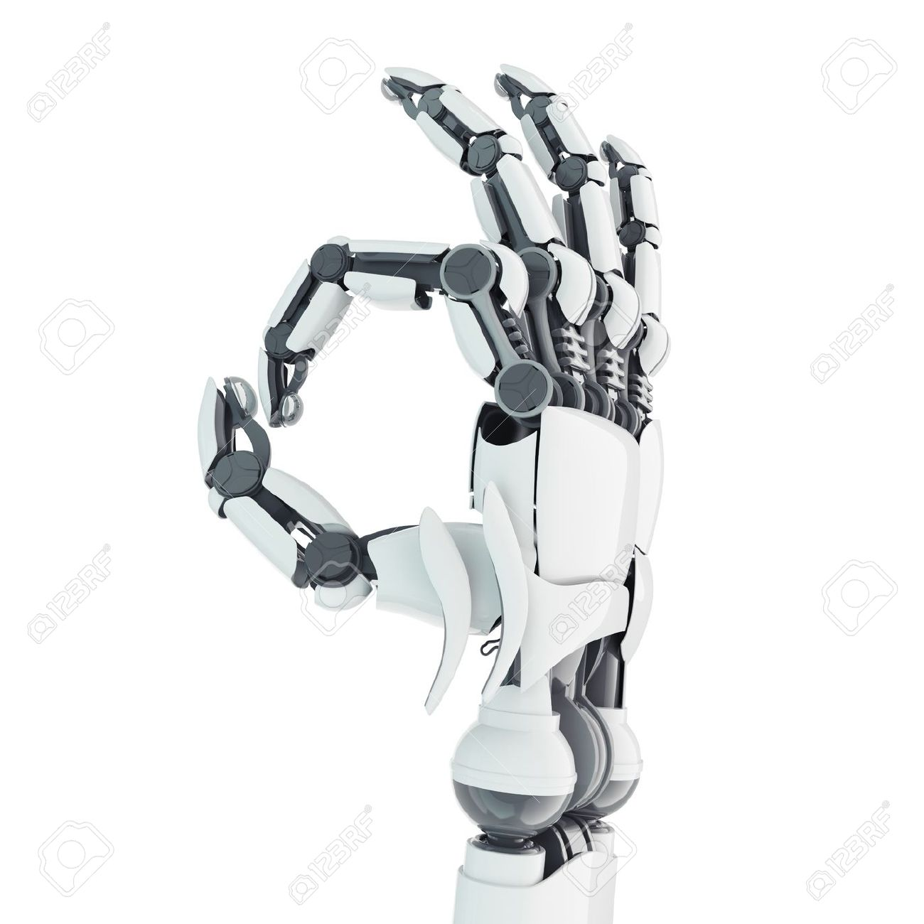

Data Structures
2
Contain multiple objects, usually of same type
Long[]
7
5
1
6
1
5
4
ArrayList<Robot>
4
5
3
7
2
7
0
1
5
0
5
Notes:
These # might be the only data structures you’ve seen so far. But data can be structured in unlimited ways. The best way to structure any data set is the way that most clearly reflects the relationships among the objects that you’re representing.

Slide 24
Data Structures
Contain multiple objects, usually of same type
Describe relationships among the objects

Slide 25
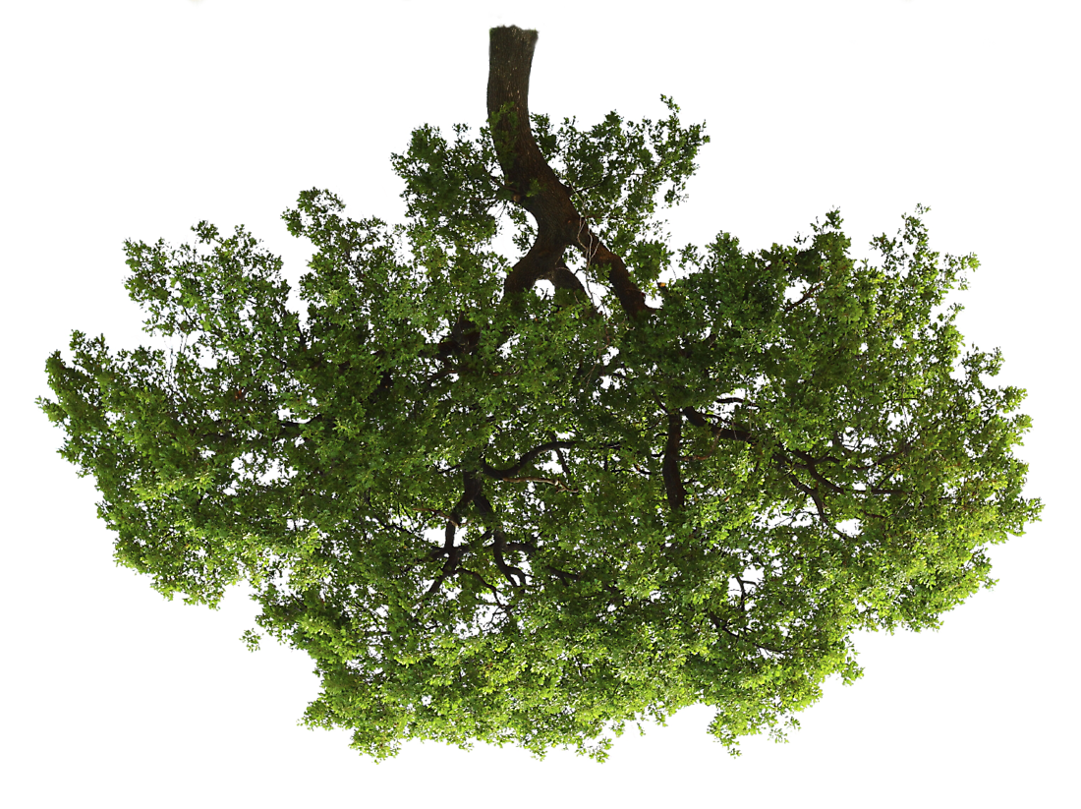
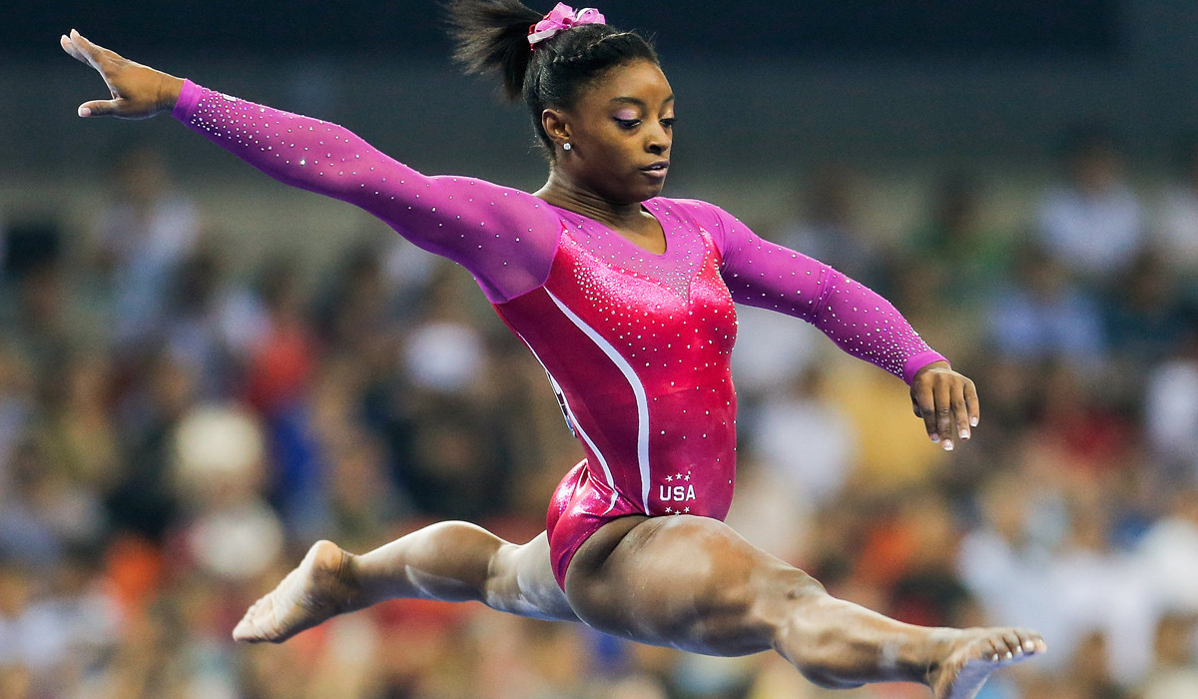
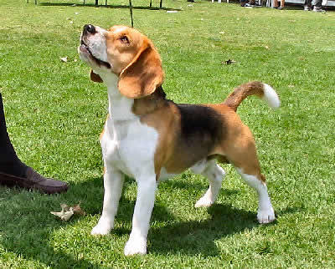
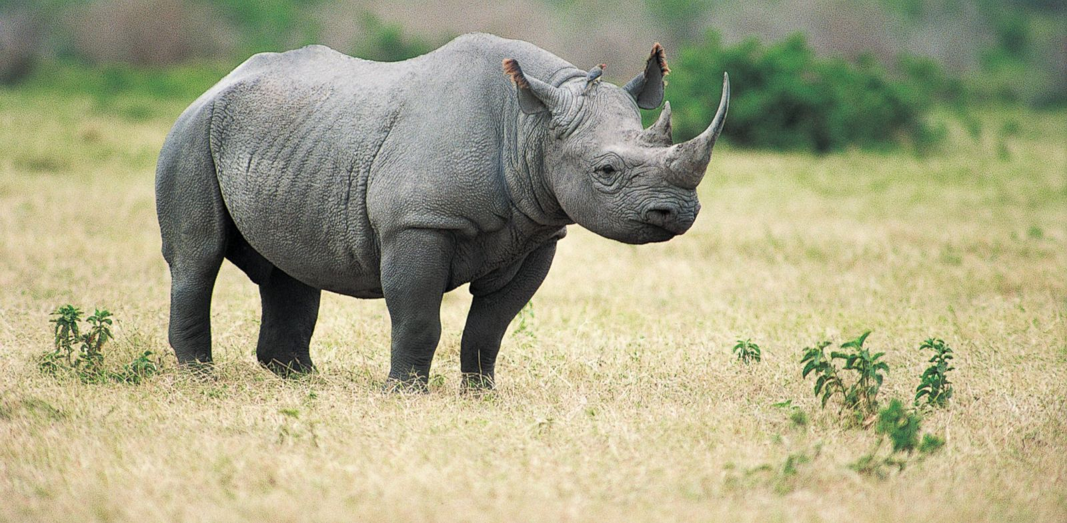
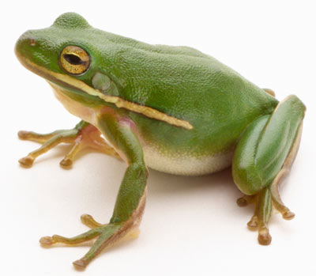
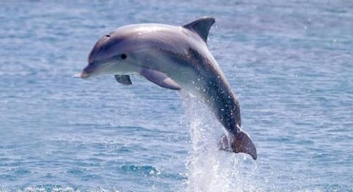
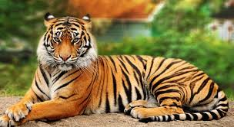
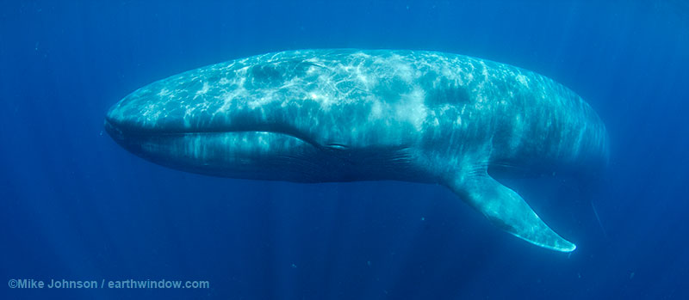
104 lbs
22 lbs
3000 lbs
1 oz
90 lbs
700 lbs
350,000 lbs
Notes:
Can you see the relationships here? Every animal weighs less than the animals below and to the left of it, and more than the animals below and to the right.
This structure is called a tree. Now I know what you’re thinking: if that’s a tree then it’s upside down. # # But this is just the way we draw them on paper or slides, because we usually start drawing at the top of a page. Of course this is just a representation of a data structure inside a computer’s memory, where there is no up or down.

Slide 26
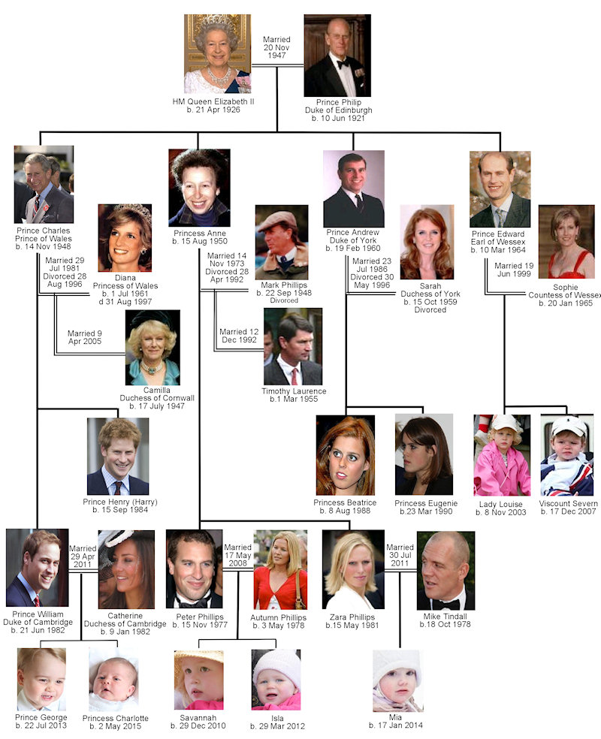
Notes:
Here’s another tree: a family tree. The shape is about the same as the other tree but the relationships are different.
Horizontal line = married/remarried
Vertical line = child of

Slide 27
Data Structures
Contain multiple objects, usually of same type
Describe relationships among the objects
A way to process the objects in order

Slide 28
2
1
ArrayList<Robot>
0
Notes:
Sometimes it’s obvious what “in order” means. With an array list, “order” = order of insertion into the list. # Maybe you care about something besides order of insertion. Maybe to you “order” means weight of the robot, or the probability that it will rise up against humanity and destroy us. If that’s what you care about, you need a different data structure. Knowing what structures are appropriate to what situations is fundamental to being a skillful programmer. Sometimes you can use structures that come provided in the core Java classes. Sometimes you need to build your own. Mostly in this course you’ll use provided structures like Array Lists, sets, and maps. A lot of this course will be about how to use those structures and the principles that govern them. But at the end of the semester we’ll look at building your own.

Slide 29
Notes:
For the royal family, useful order might be who’s next in line for the throne, like this. #

Slide 30
Notes:
Or it might be order of walking into the grand ballroom at grand party. Maybe that’s like this: #
A royal-family data structure is pretty specific. You probably won’t find the Java code for one by googling or going to stack overflow. For interesting work, you’ll have to create your own application data structures. That’s why it’s important to study them in this class, and to do your labs and homework in order to develop your programming skills.

Slide 31
101 lbs
22 lbs
3000 lbs
1 oz
110 lbs
700 lbs
350,000 lbs
Notes:
What is the right traversal order here? Notice that everything in every left subtree weighs less than the object immediately above, and everything in every right subtree weighs more. Traversal order = ascending weight, and the structure of the tree makes it easy to write code that implements the increasing-weight traversal order. That might not be obvious to you today, but it will be in a few months.

Slide 32
101 lbs
22 lbs
3000 lbs
1 oz
110 lbs
700 lbs
350,000 lbs

Slide 33
Data Structures
Contain multiple objects, usually of same type
Describe relationships among the objects
A way to process the objects in order
Algorithms + supplemental classes for building & maintaining the structure

Slide 34
Notes:
If you’re one of those algorithms, the data structure looks like this:

Slide 35
class Node {
Animal data;
Node left;
Node right;
}
Notes:
If your job is to implement a general-purpose tree structure, the contents (the rhino or the dolphin or Simone or their weights) aren’t important to you. What matters to you are the relationships. Structures like this often use a Node class that contains data and maintains relationships. Here we have 7 nodes, each drawn in a different color.

Slide 36
Data Structures
Contain multiple objects, usually of same type
Describe relationships among the objects
A way to process the objects in order
Algorithms for building & maintaining the structure
Conventions for easy communications with other people:
Nodes: hold data, represent relationships
Iterators: present data “in order” to other software
Notes:
In this business, everybody agrees that a node is a class that holds data objects, and represents the relationships among them.
Also everybody agrees that an iterator is a class that presents structured data in the correct order. The meaning of “correct order” will be the subject of future lectures, homework, and exams.

Slide 37
Data Structures
Contain multiple objects, usually of same type
Describe relationships among the objects
A way to process the objects in order
Algorithms for building & maintaining the structure
Conventions for easy communications with other people:
Nodes: hold data, represent relationships
Iterators: present data “in order” to other software
Notes:
So that’s a very shallow description of what software data structures are, and if you read the 46B course description it can make you believe that the business of this course is to learn these topics. That’s true, but it’s only half the truth. The other business of this course is to develop your programming skills. I want you to graduate from here, and get great jobs writing software that will make the world a better place. That can only happen if you can write high-quality code. So let’s get started.

